Slide 1
Term 3 Project
Customer Analytics
Domain : E-Commerce Industry
By :
Blesson

Slide 2
Agenda
Customer Analytics
Case Study Background
Solution Approach
Understanding the Data
Data Insight and Visualization
Pre-processing Data
Model Building and Evaluation
Problem Statement 1 – Supervised Learning Models
Problem Statement 2 – Data Insight and Visualization
Problem Statement 3 – Clustering K-Means
Problem Statement 4 – Twitter Sentimetn Analysis

Slide 3
Customer Analytics
Customer analytics is a process by which data from customer behavior is used to help make key business decisions via market segmentation and predictive analytics.
This information is used by businesses for direct marketing, site selection, and customer relationship management.

Slide 4

Case Study Background
An International E-Commerce company(Electronic goods) wants to use some of the most advanced machine learning techniques to analyze their customers with respect to their services and some important customer success matrix. They also have future expansion plans to India.
They have some specific key insights to be found out from their existing customer database.

Slide 5
Our Solution Approach
Understanding the data
Pre-Processing of Data
Model Building and Evaluation
Prediction for Test data
Converting variables to factors
Data visualization using SEABORN
Splitting data into Training & Test
Fitting the model
Exploratory Data Analysis

Slide 6
Understanding the Data
Variable | Description
ID | Id number of the customer
Warehouse_block | The company has a big warehouse which is divided in various blocks such as A,B,C,D and so on.
Mode_of_Shipment | The company ships the products by different modes of transport such as ship, air and road
Customer_care_calls | this variable indicates the number of calls made for enquiry of the shipment.(Sometimes customer make too many calls, hence the company wants to know that are these customers unknowingly favoured.
Customer_rating | The company has rated every customer on various parameters, 1 being the lowest (Worst), 5 being highest (Best)
Cost_of_the_Product | It is the cost of the product in USD
Prior_purchases | This variable indicates the number of prior purchases
Product_importance | The company has categorised the products in the range of high, medium and low based on various parameters
Gender | Male or female
Discount_offered | it is the percentage of discount offered on that specific product.
Weight_in_gms | It is the weight in grams
Reached.on.Time_Y.N | It is the Y variable, where 1 Indicates that the product has NOT reached on time and 0 indicates it has reached on time

Slide 7
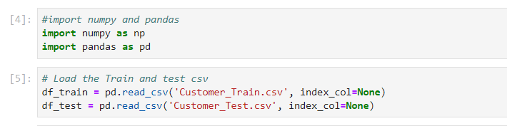
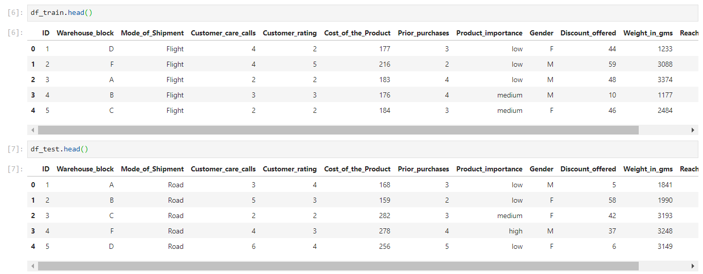
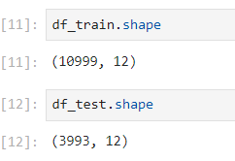
Understanding the Data (Exploratory Data Analysis)

Slide 8
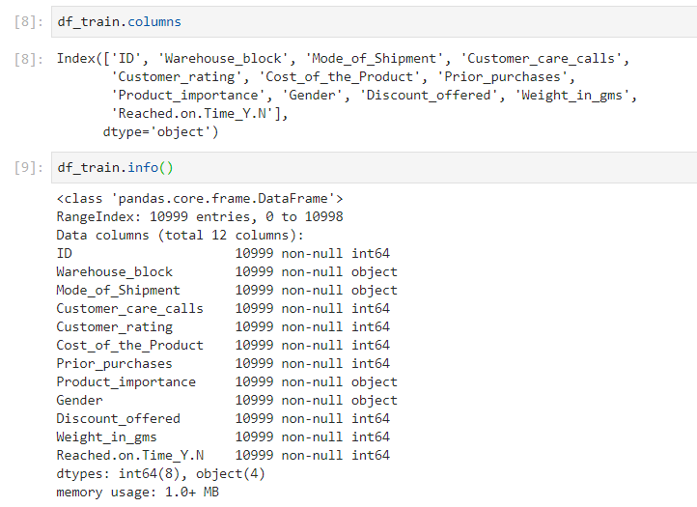
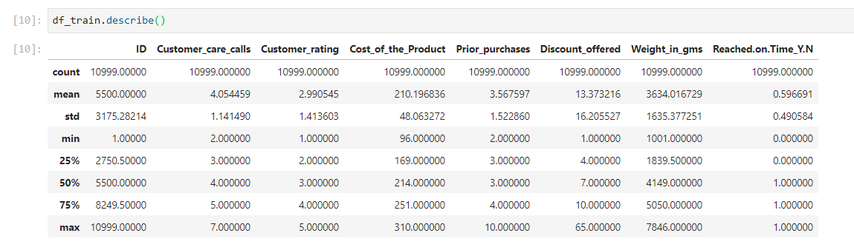
Understanding the Data (Exploratory Data Analysis)

Slide 9
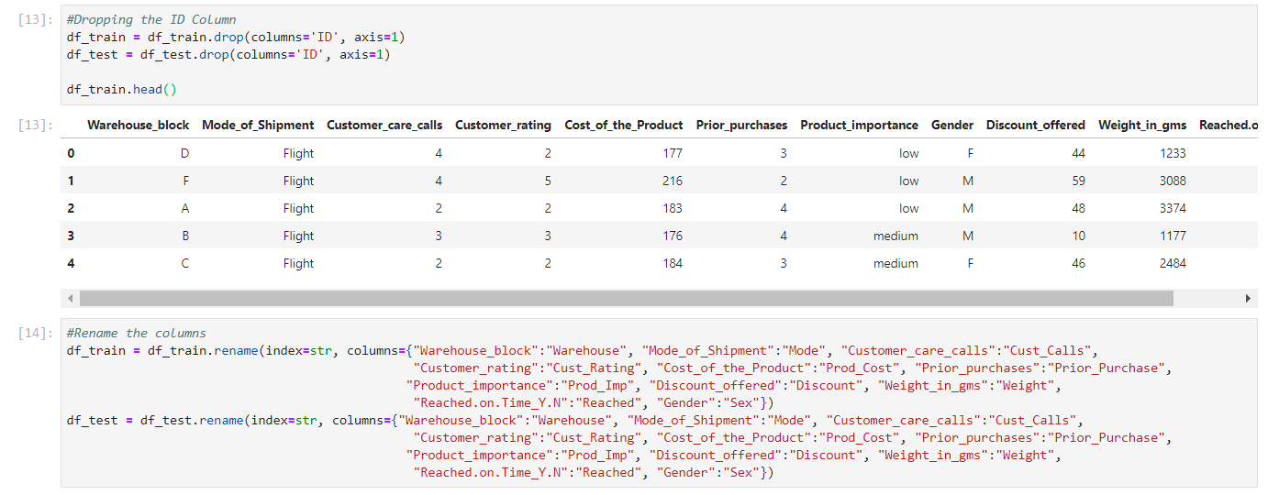
Cleaning the Category Columns

Slide 10
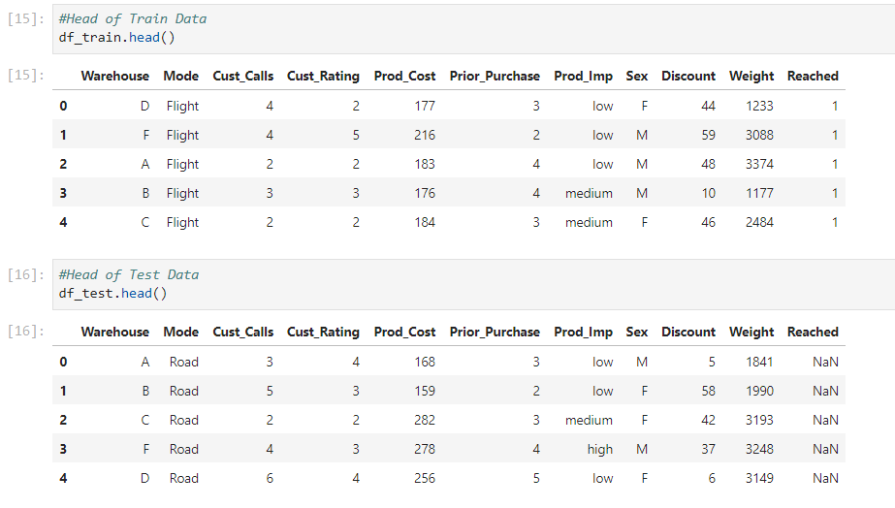
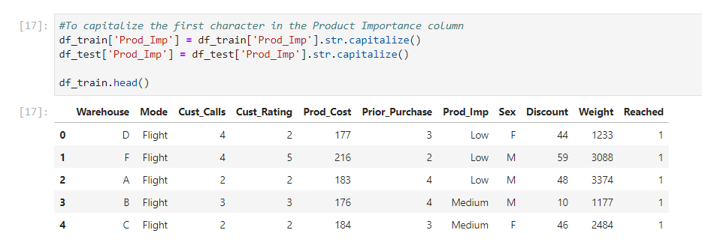
Cleaning the Category Columns

Slide 11
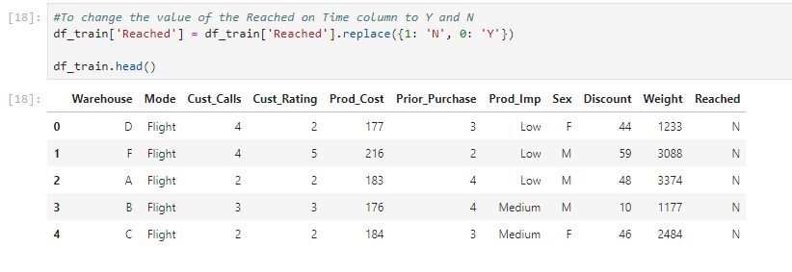
Cleaning the Category Columns

Slide 12
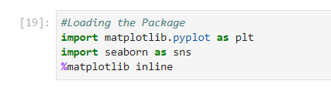
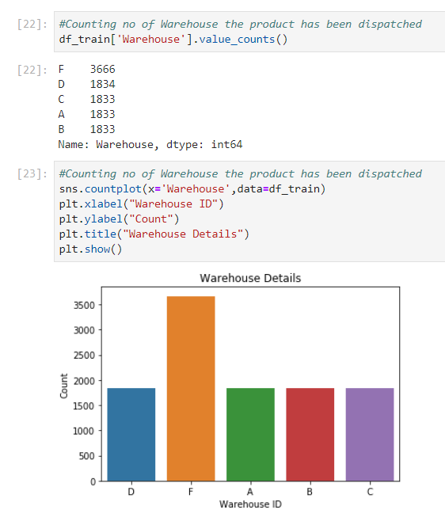
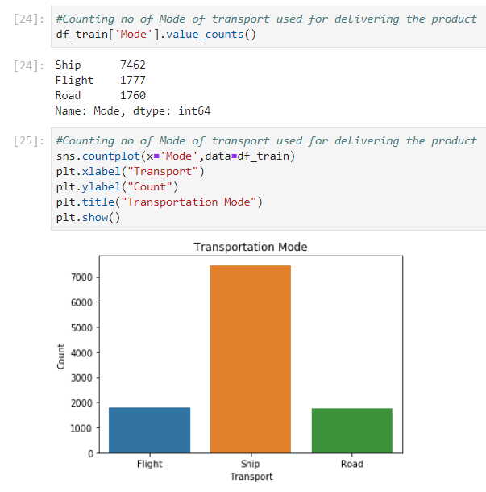
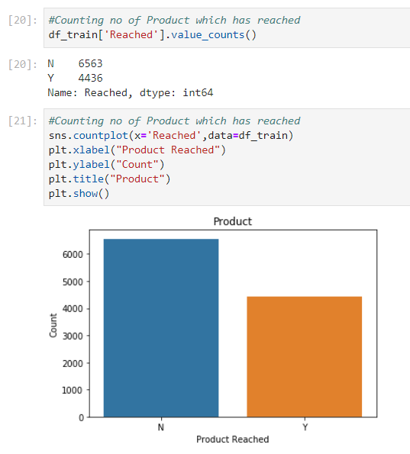
Data Insight and Visualization

Slide 13
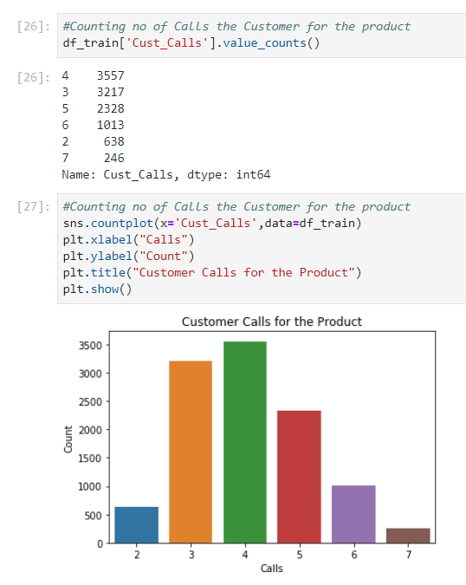
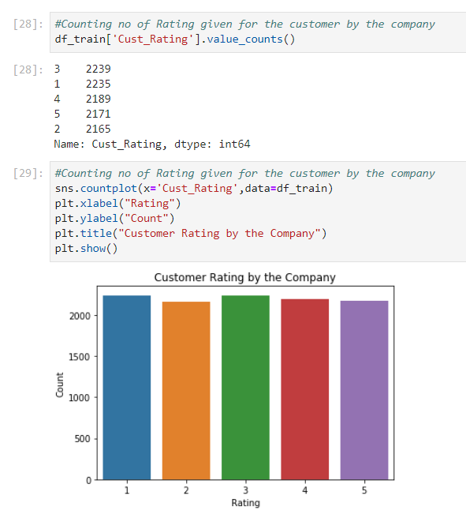
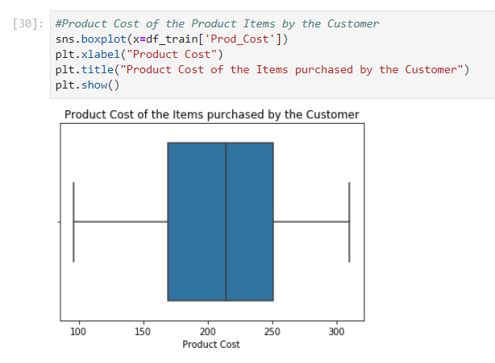
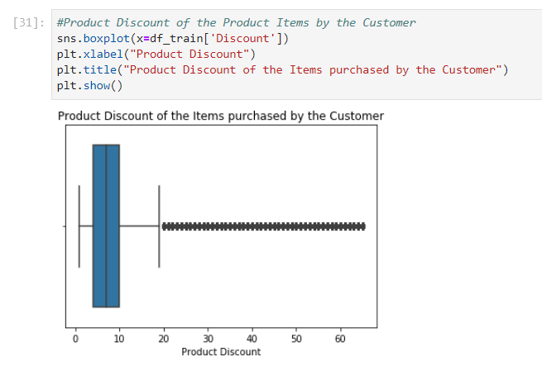
Data Insight and Visualization

Slide 14
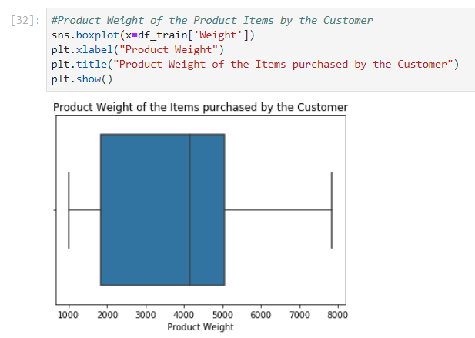
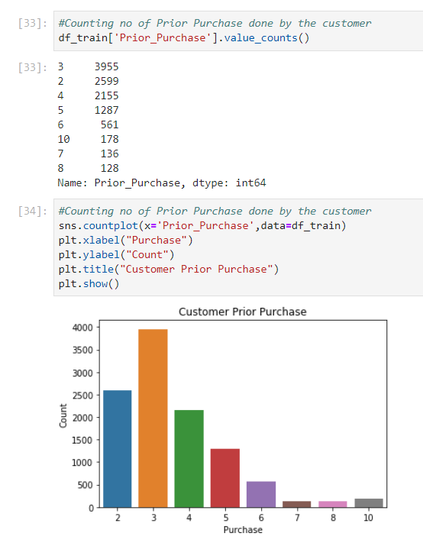
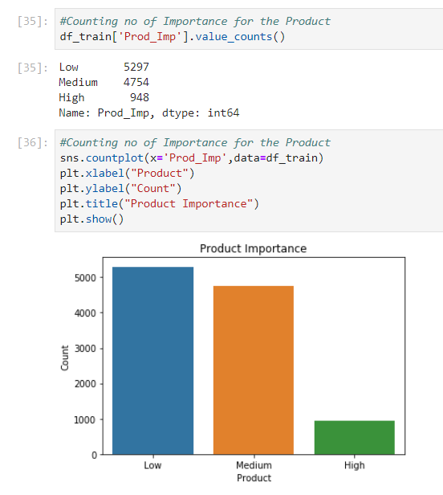
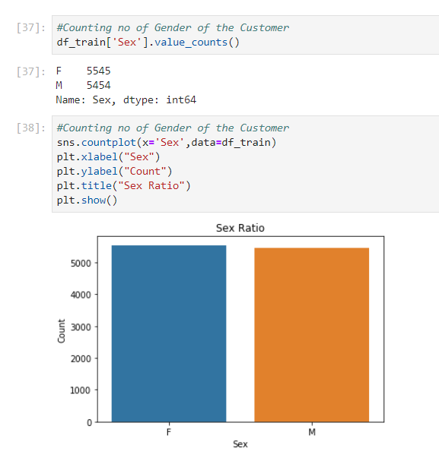
Data Insight and Visualization

Slide 15
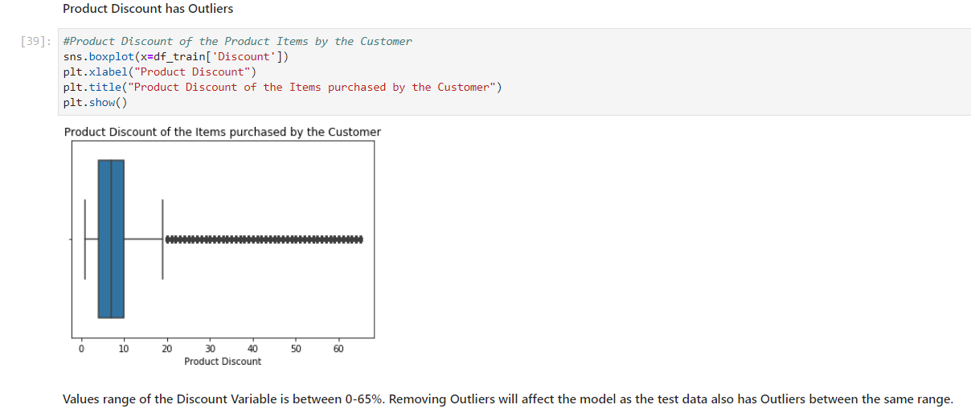
Outlier Detection

Slide 16
Pre-processing of data (Missing Value Treatment)
No Missing Value found in the Train and Test Data

Slide 17

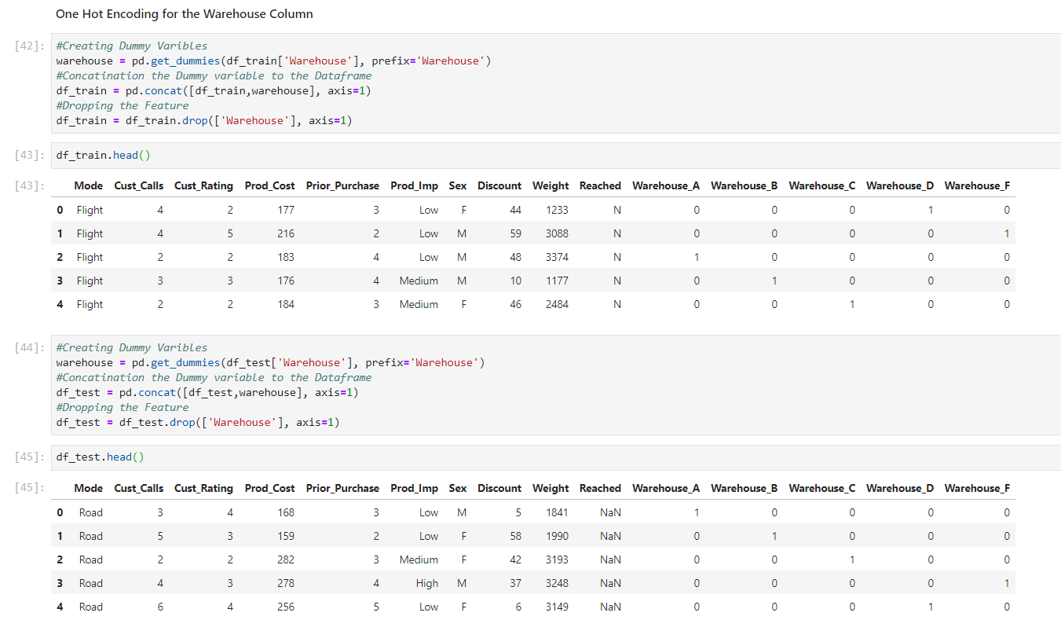
Feature Engineering(Converting variables to Factors)

Slide 18
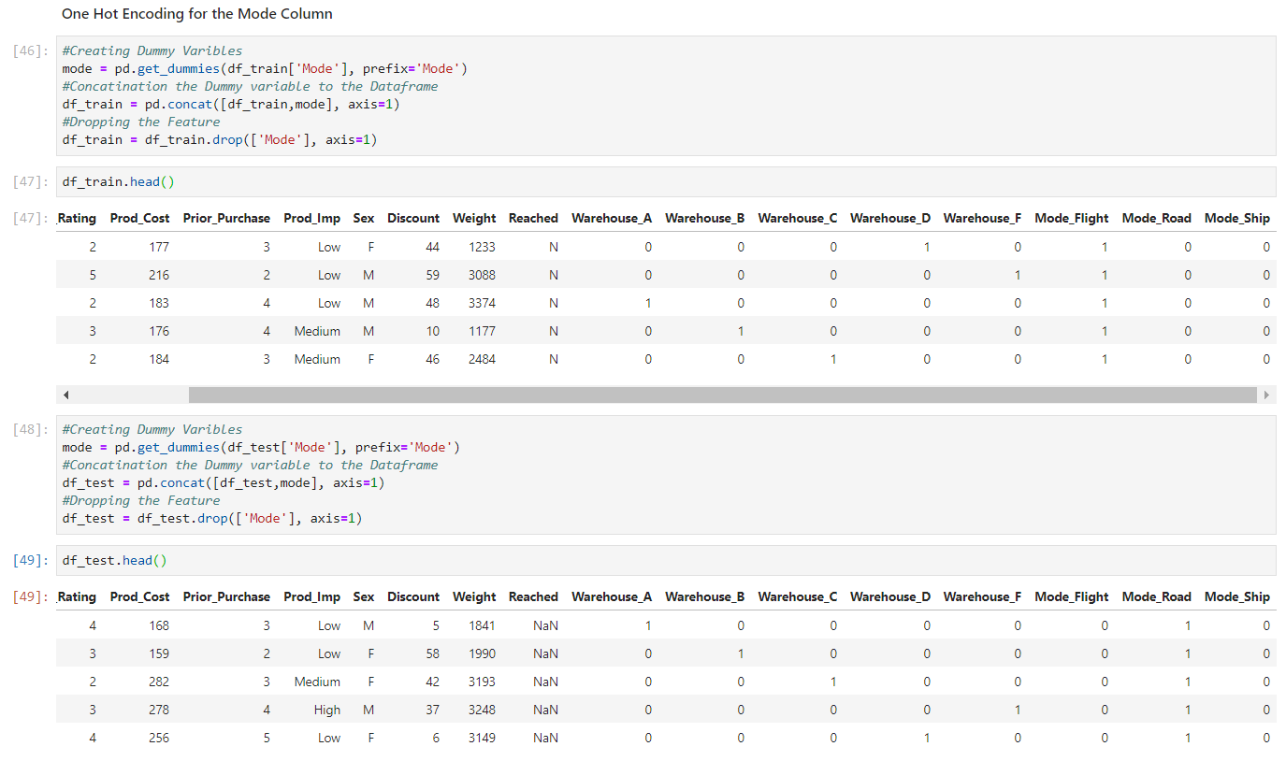
Feature Engineering(Converting variables to Factors)

Slide 19
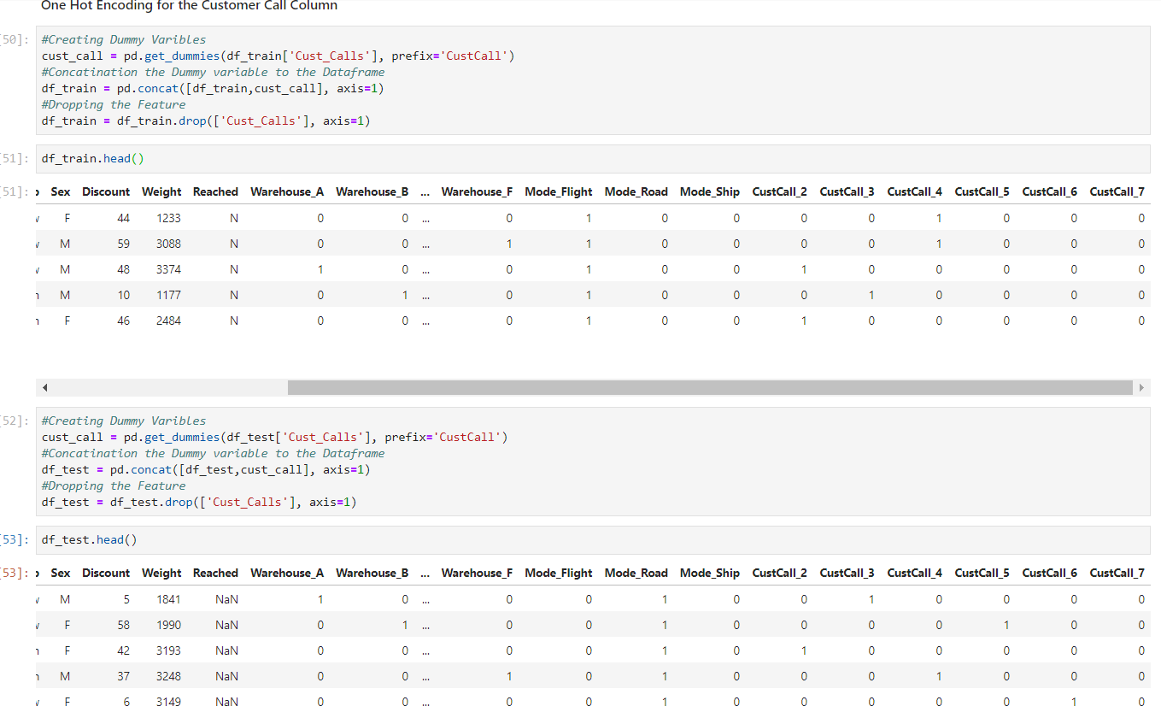
Feature Engineering(Converting variables to Factors)

Slide 20
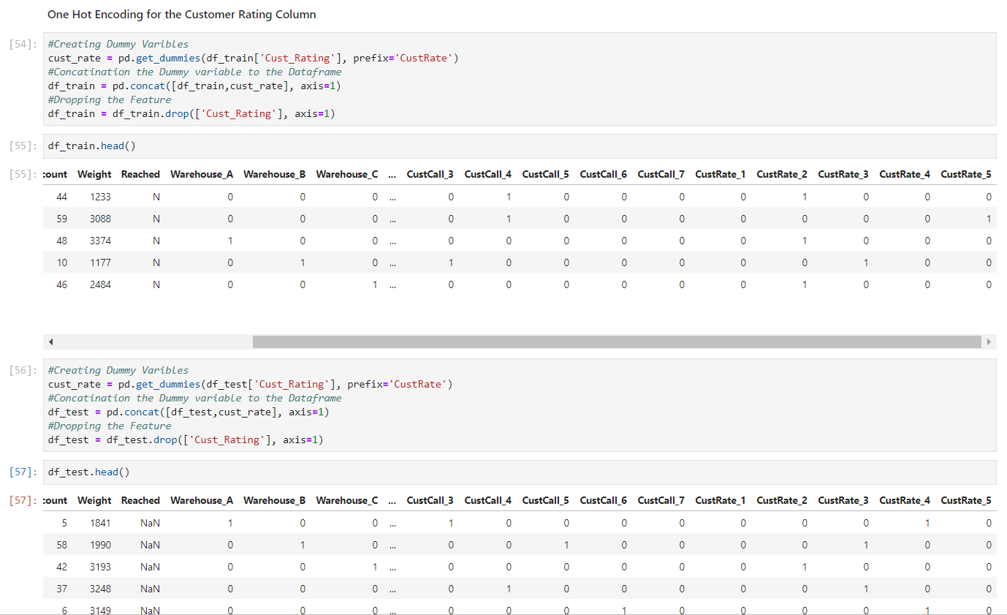
Feature Engineering(Converting variables to Factors)

Slide 21
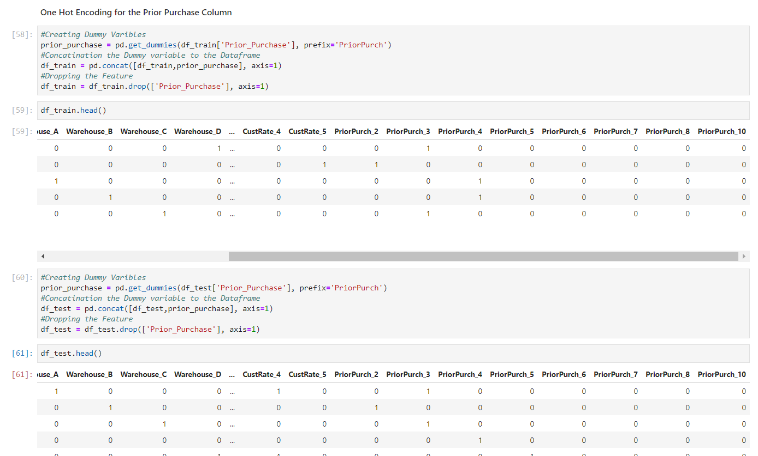
Feature Engineering(Converting variables to Factors)

Slide 22
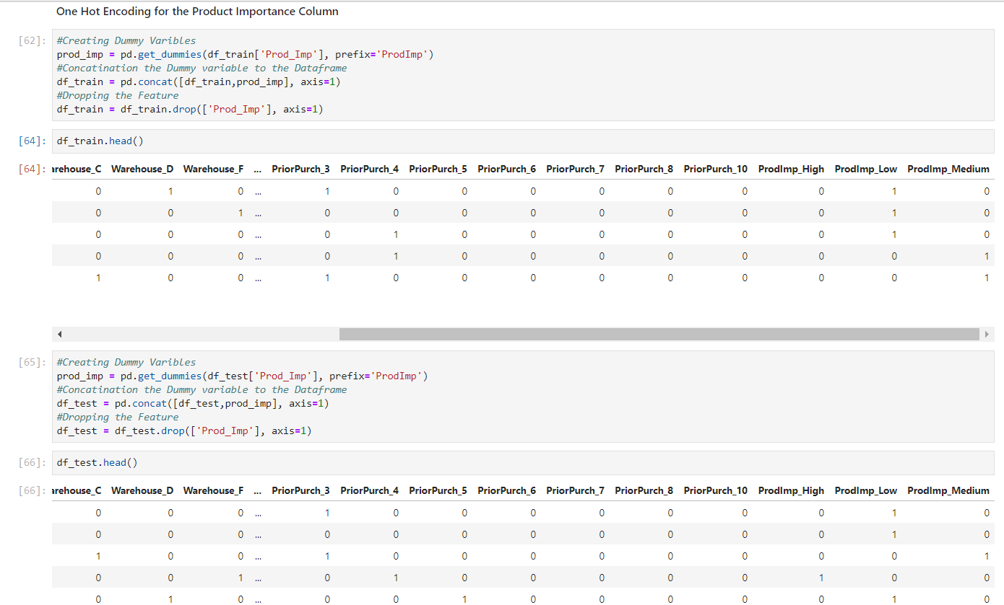
Feature Engineering(Converting variables to Factors)

Slide 23
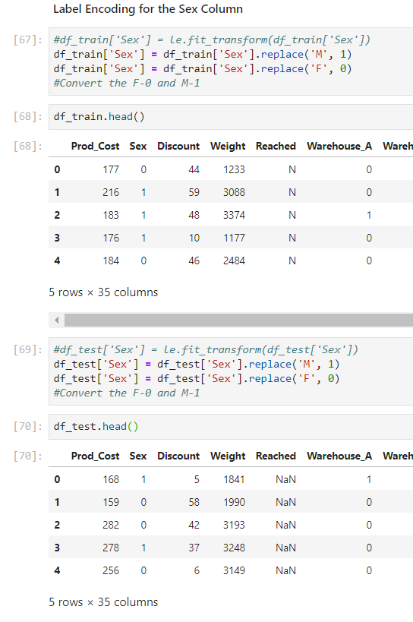
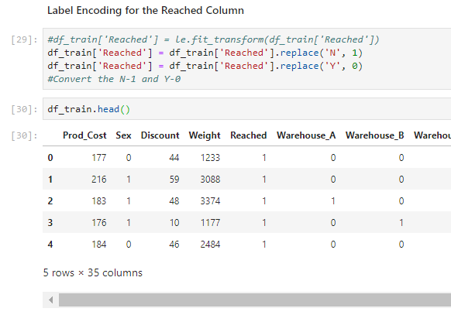
Feature Engineering(Converting variables to Factors)

Slide 24
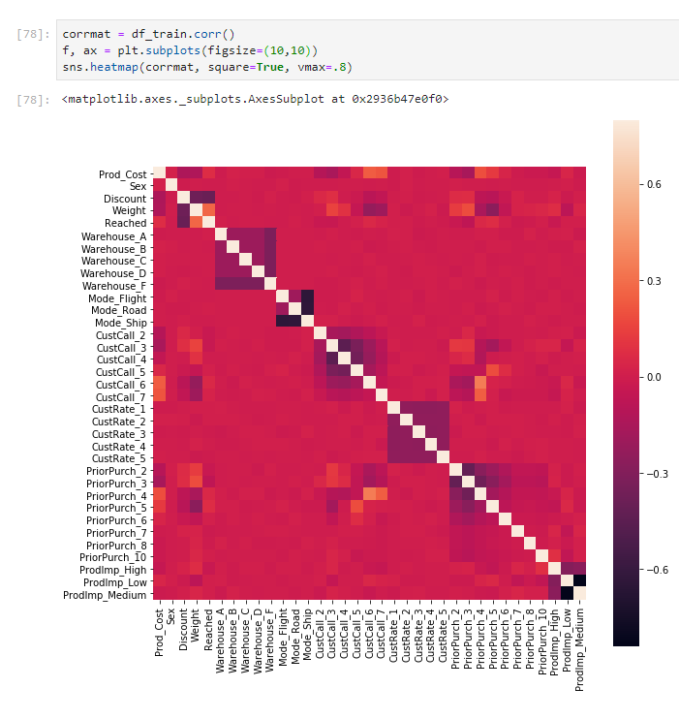
Model Building and Evaluation(Correlation)

Slide 25
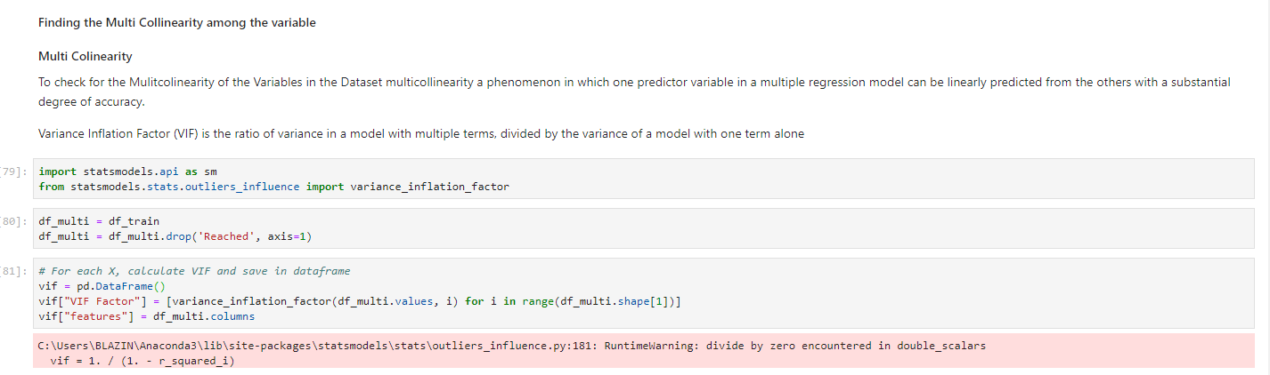
Model Building and Evaluation(Multi Collinearity)

Slide 26
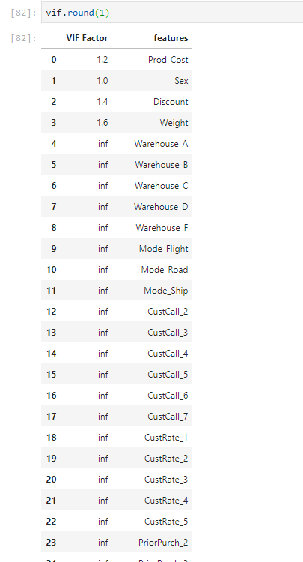
Model Building and Evaluation(Multi Collinearity)

Slide 27
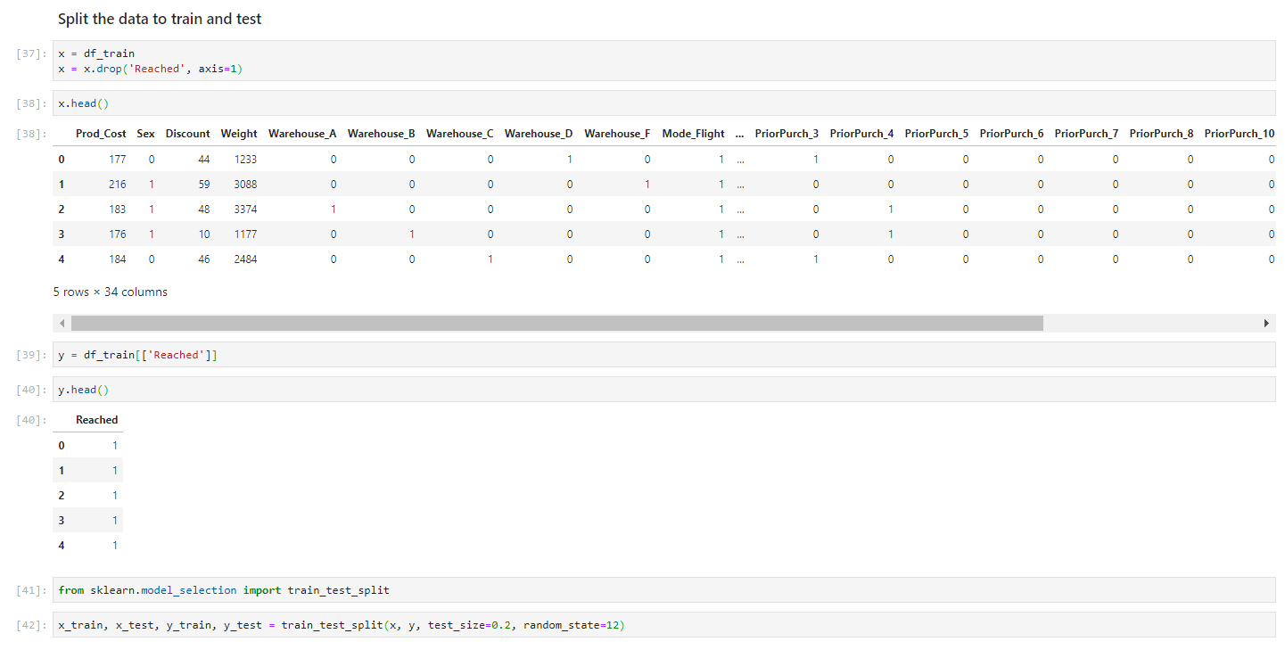
Model Building and Evaluation(Train Test Data Split)

Slide 28
As a Data Scientist, they want you to build a model to predict if the shipments are or will reach on time or not.
For this, they want you to use various Logit/Probabilistic techniques with the most accurate model. The main models they want you to build and compare the accuracy are:
1. Logistic Regression
2. Support Vector Machines
3. Random Forest
4. XgBoost or any other boosting technique.
We will use Python to analyze and make a prediction.
Problem Statement - 1
Problem Statement
Objective
The objective of this Project is to predict if the shipments are or will reach on time or not.

Slide 29

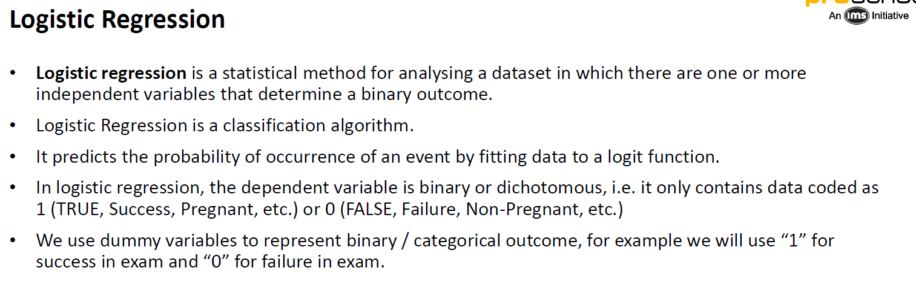
Model Building and Evaluation – Logistic Regression

Slide 30
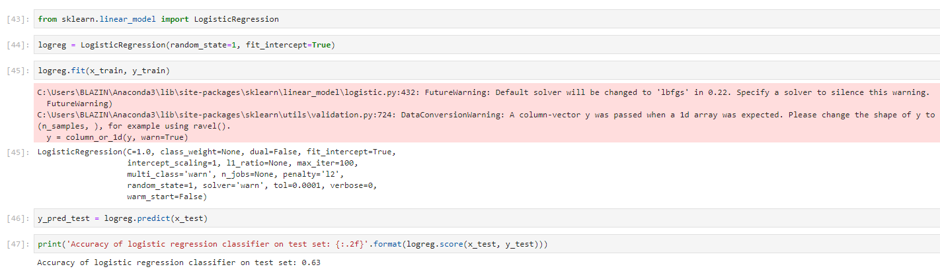
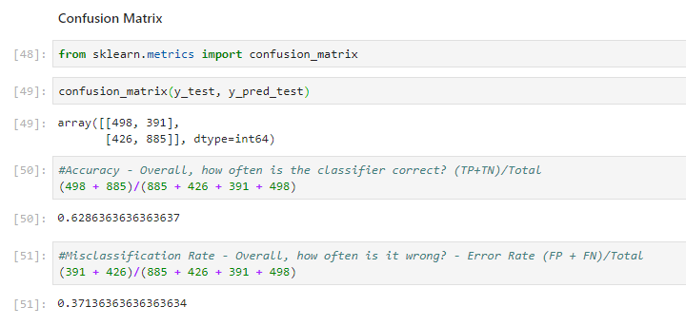
Model Building and Evaluation – Logistic Regression

Slide 31
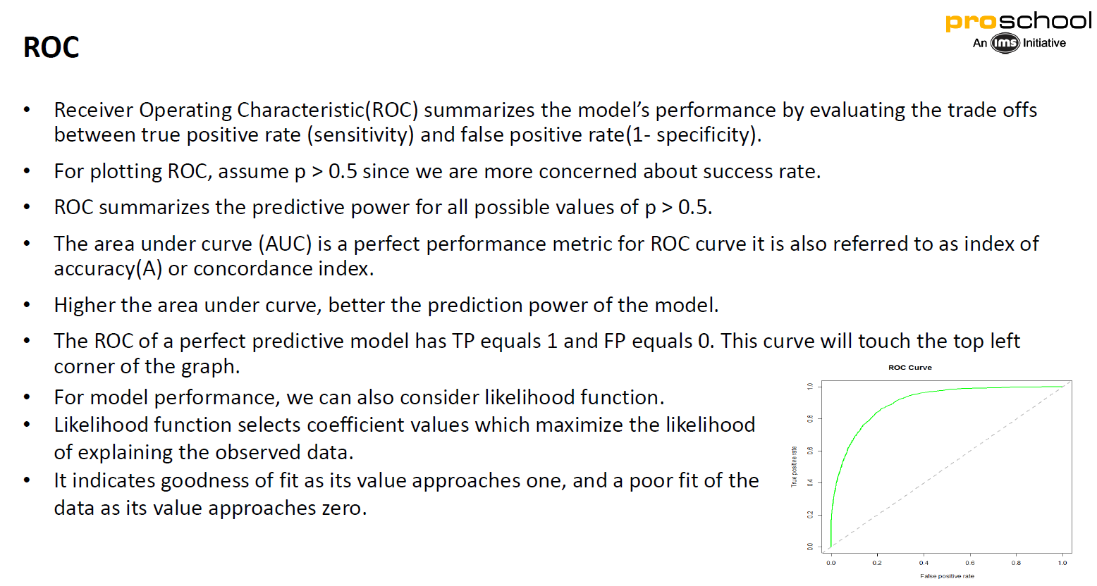

Model Building and Evaluation (ROC Curve)

Slide 32
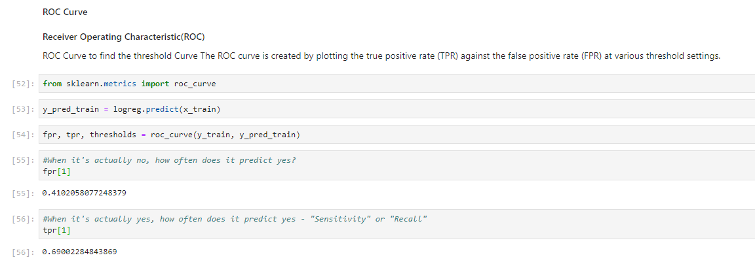
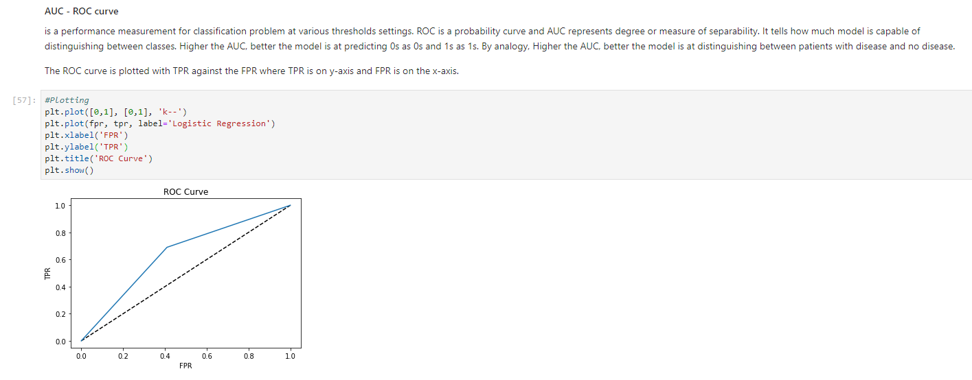
Model Building and Evaluation (ROC Curve)

Slide 33
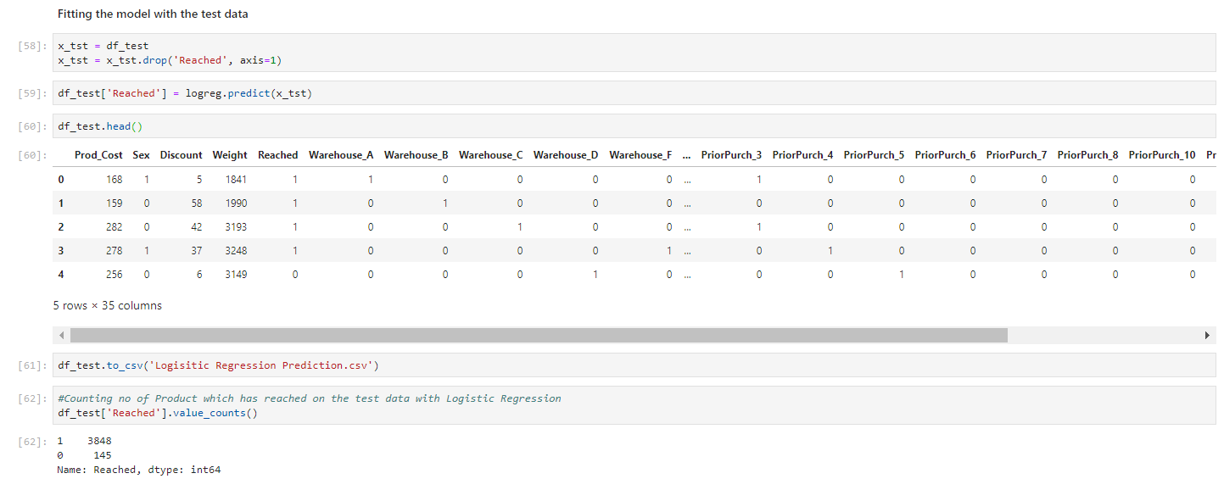
Logistic Regression (Prediction for Test data)
The final conclusion that we can derive from the Test Data for the E-Commerce Customer Analysis is that out of 3993 total records that we can predict 3848 couriers not to be delivered and 145 Couriers to be delivered.

Slide 34
Model Building and Evaluation – Support Vector Machine
A Support Vector Machine (SVM) is a discriminative classifier formally defined by a separating hyper plane. In other words, given labeled training data (supervised learning), the algorithm outputs an optimal hyper plane which categorizes new examples. In two dimensional space this hyper plane is a line dividing a plane in two parts where in each class lay in either side.
Tuning Parameters
1. Kernel
The learning of the hyper plane in linear SVM is done by transforming the problem using some linear algebra. This is where the kernel plays role.
a. Linear kernel the equation for prediction for a new input using the dot product between the input (x) and each support vector (xi) is calculated as follows:
f(x) = B(0) + sum(ai * (x,xi))
b. Polynomial kernel can be written as K(x,xi) = 1 + sum(x * xi)^d and exponential as K(x,xi) = exp(-gamma * sum((x — xi²)).
Polynomial and exponential kernels calculates separation line in higher dimension. This is called kernel trick
2. Regularization
The Regularization parameter (often termed as C parameter in python’s sklearn library) tells the SVM optimization how much you want to avoid misclassifying each training example.
3. Gamma
The gamma parameter defines how far the influence of a single training example reaches, with low values meaning ‘far’ and high values meaning ‘close’. In other words, with low gamma, points far away from plausible separation line are considered in calculation for the separation line. Where as high gamma means the points close to plausible line are considered in calculation.

Slide 35
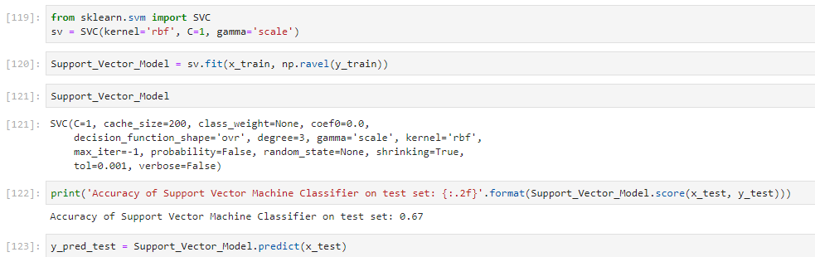
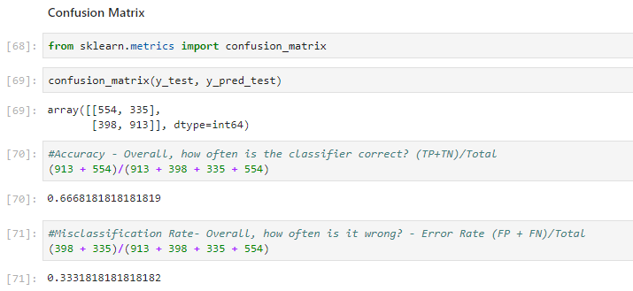
Model Building and Evaluation – Support Vector Machine

Slide 36
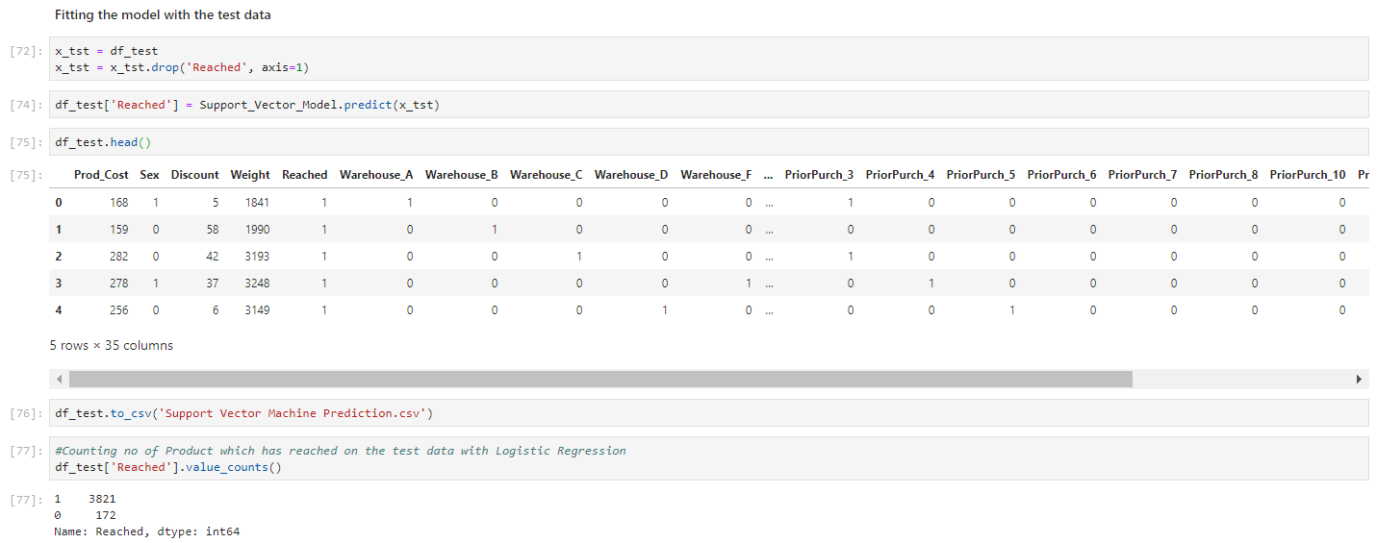
Support Vector Machine (Prediction for Test data)
The final conclusion that we can derive from the Test Data for the E-Commerce Customer Analysis is that out of 3993 total records that we can predict 3821 couriers not to be delivered and 172 Couriers to be delivered.

Slide 37
Model Building and Evaluation – Random Forest
Random Forest Classifier
Random Forest Classifier is ensemble algorithm. Random forest algorithm is a supervised classification algorithm. As the name suggest, this algorithm creates the forest with a number of trees.
1. Entropy
Entropy is degree of randomness of elements or in other words it is measure of impurity. Mathematically, it can be calculated with the help of probability of the items as:
H(X) = -Sumof(P(x) * log2(P(x)))
2. Gini Index
Suppose we have multiple features to divide the current working set. What feature should we select for division? Perhaps one that gives us less impurity.
Suppose we divide the classes into multiple branches as follows, the information gain at any node is defined as
Information Gain (n) = Entropy(x) — ([weighted average] * entropy(children for feature))

Slide 38
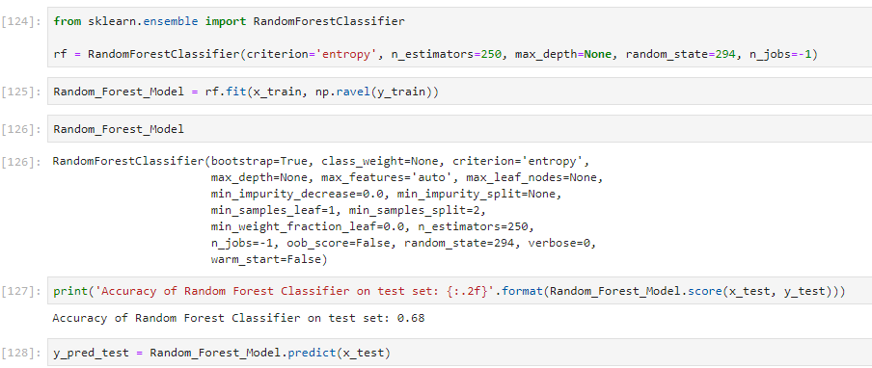
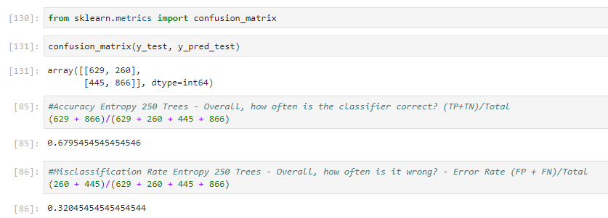
Model Building and Evaluation – Random Forest

Slide 39
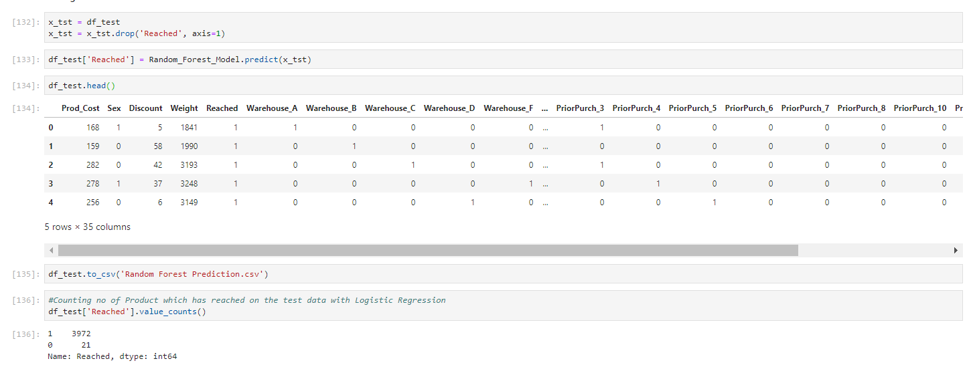
Random Forest (Prediction for Test data)
The final conclusion that we can derive from the Test Data for the E-Commerce Customer Analysis is that out of 3993 total records that we can predict 3972 couriers not to be delivered and 21 Couriers to be delivered.

Slide 40
Model Building and Evaluation – xgBoost
Boosting
1. Boosting is an ensemble method that uses number of weak classifiers to create a strong classifier
2. Weak Classifier is defined as one whose performance is at least slightly better than random classifying
3. First we create first model(Weak Model) by using the training data The second model is built to reduce the error in classification of the first model and by assigning weights for wrongly classified data and so on
4. This process will be continued till maximum number of models added or else till we reach perfect predictions
5. Boosting controls both bias variance, and is more effective than the bagging which controls only variance

Slide 41
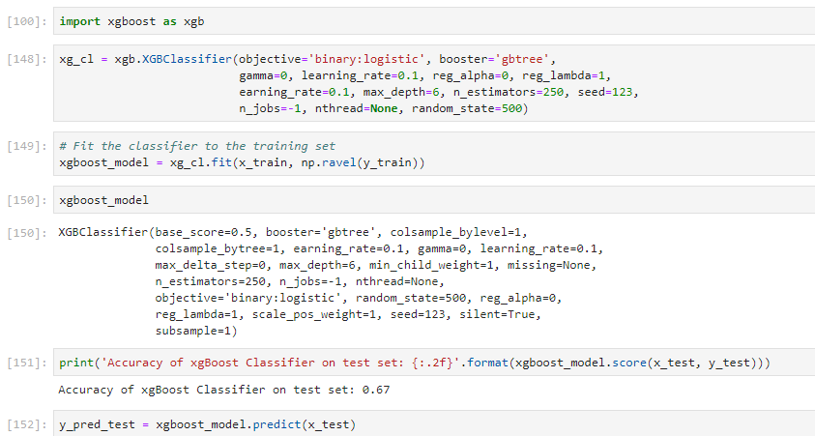
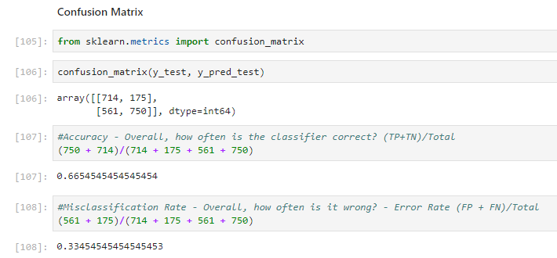
Model Building and Evaluation – xgBoost

Slide 42
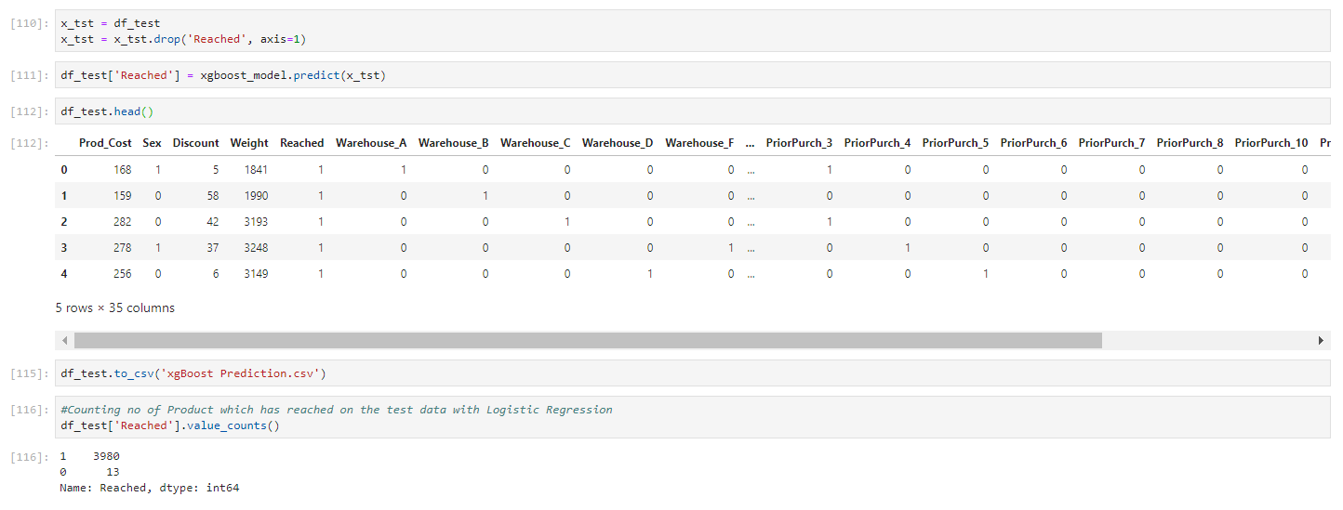
xgBoost (Prediction for Test data)
The final conclusion that we can derive from the Test Data for the E-Commerce Customer Analysis is that out of 3993 total records that we can predict 3980 couriers not to be delivered and 13 Couriers to be delivered.

Slide 43
They also want to know, if their shipments are reaching on time to their best customers who have a
1. Good customer rating.
2. Good customer score.
3. Make recurring orders.
4. Highest payment buyers
Problem Statement - 2
Problem Statement
Objective
The objective of this problem statement is to visualize the features based on the Reached Column

Slide 44


Good Customer Rating

Slide 45
Good Customer Score

Slide 46


Making Recurring Order

Slide 47

Highest Payment Buyer

Slide 48
They want you to create a customer segmentation using clustering algorithm of the customers to whom the shipments are not reaching on time.
Problem Statement - 3
Problem Statement
Objective
The objective of this problem statement is create a cluster of the customers based on the customer care calls and the customer rating where the shipments are not reached on time

Slide 49


Clustering

Slide 50


K-Means Clustering

Slide 51


Model Building and Evaluation

Slide 52

Model Building and Evaluation

Slide 53

Model Building and Evaluation – K-Means Clustering

Slide 54

Model Building and Evaluation – K-Means Clustering

Slide 55
Since the company also wants to start their operations in India, they want you to do a Sentiment analysis(Positive or Negative) of their competitors such as:
1. Amazon India
2. Flipkart
3. Snapdeal
Problem Statement - 4
Problem Statement
Objective
The objective of this problem statement is to do a Sentiment Analysis of Twitter tweets of the competitors

Slide 56


Sentiment Analysis

Slide 57


Sentiment Analysis – Amazon

Slide 58

Sentiment Analysis – Amazon

Slide 59


Sentiment Analysis – Flipkart

Slide 60


Sentiment Analysis – Snapdeal

Slide 61
Thank You

